Slide 1
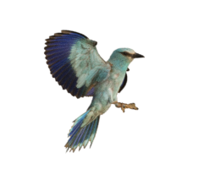
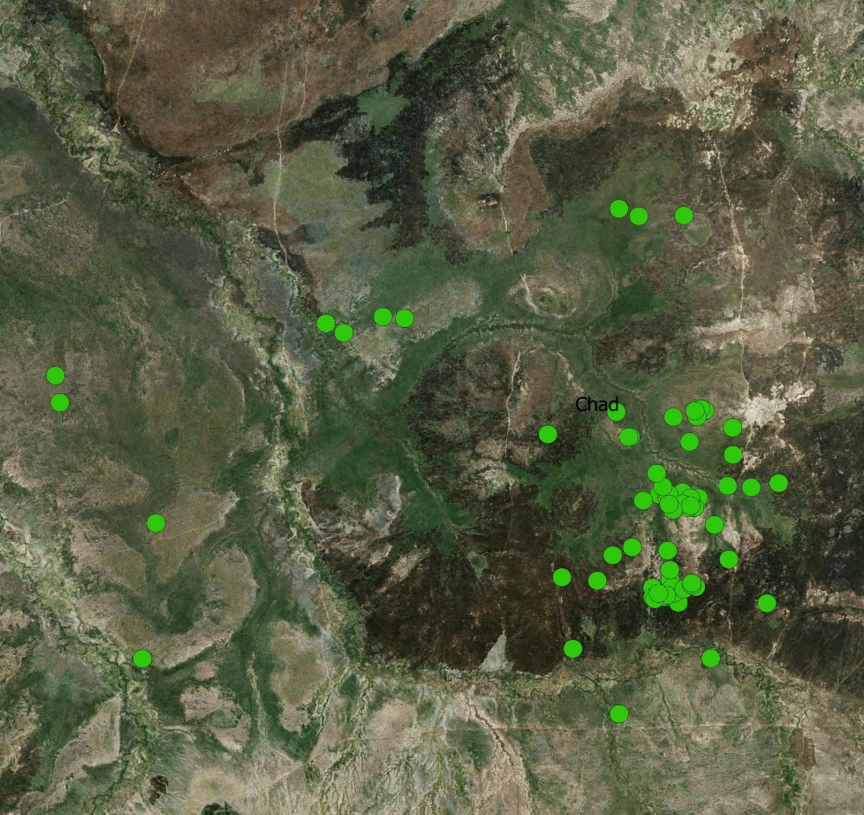
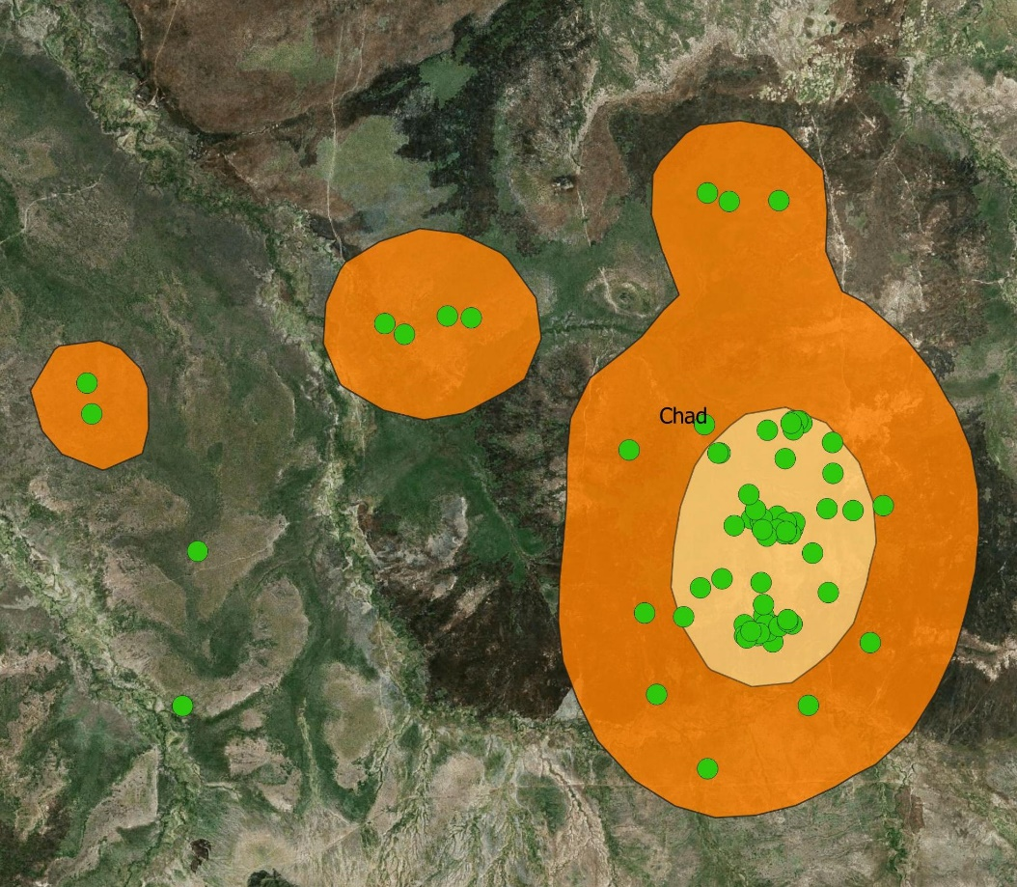
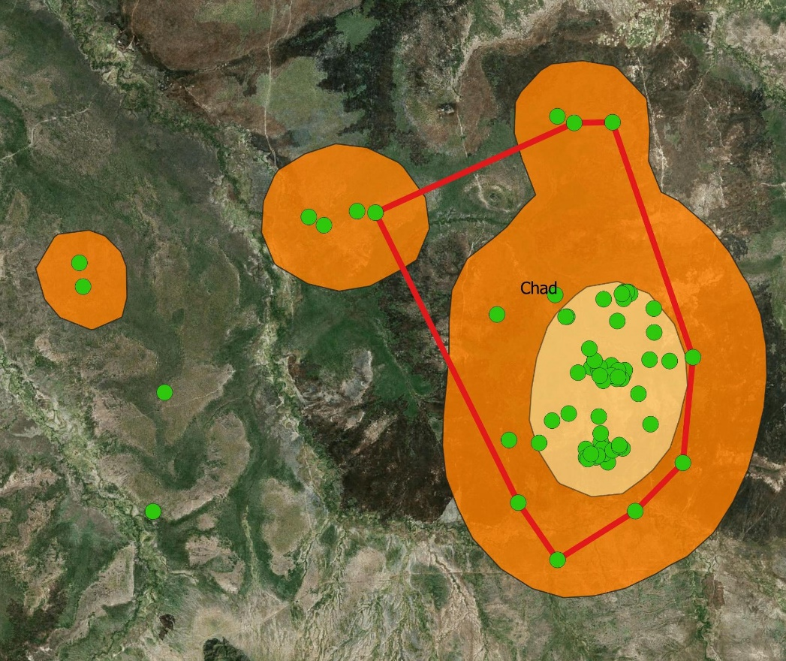
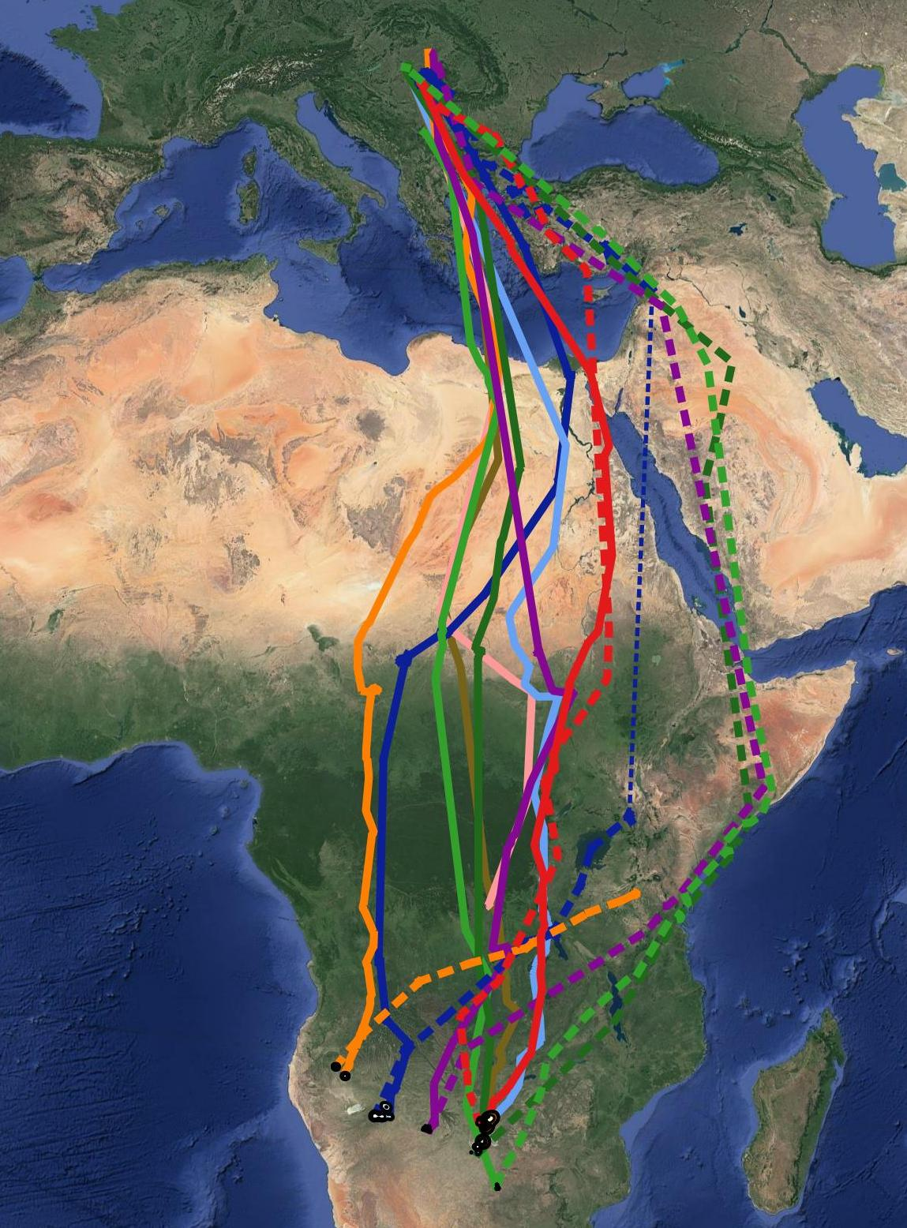
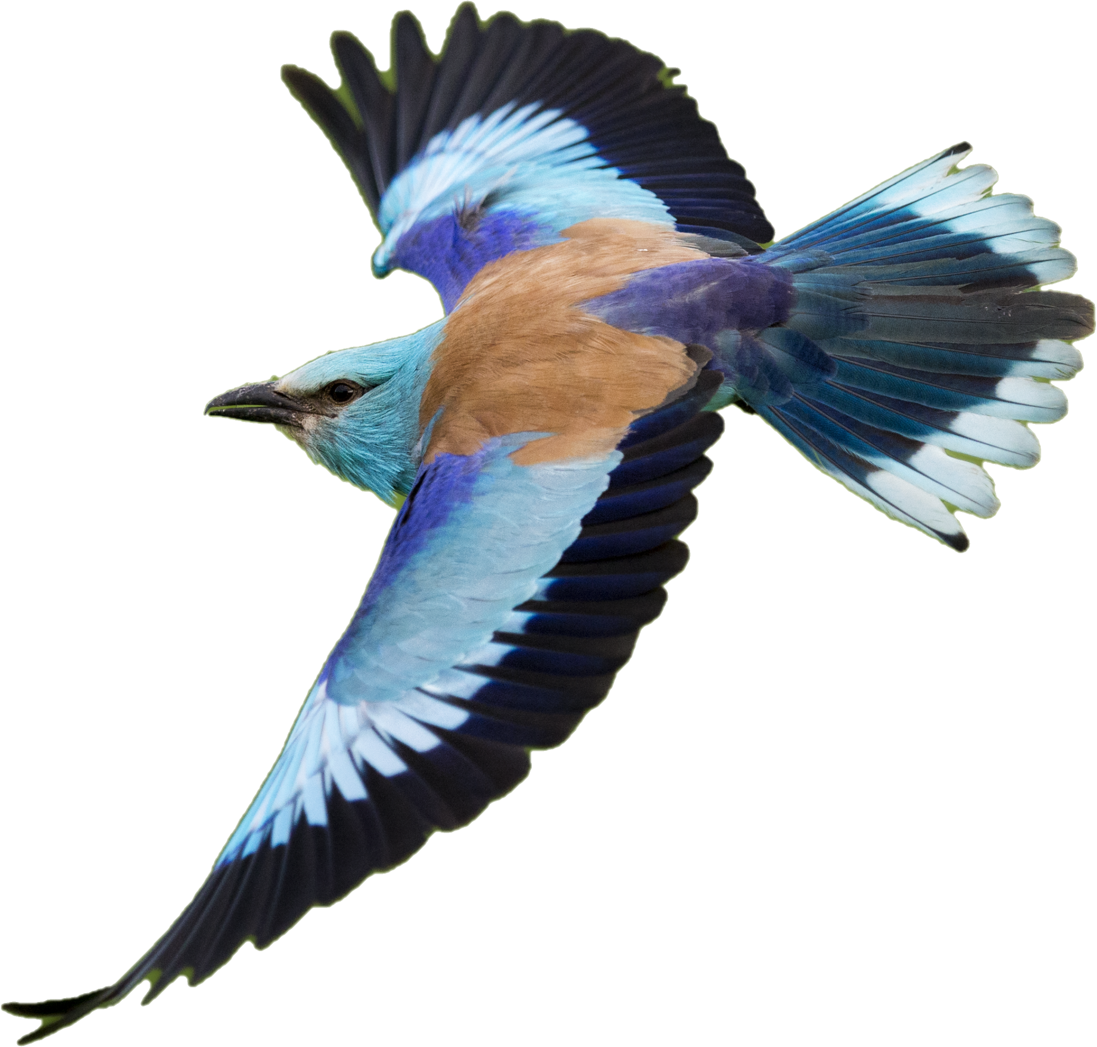
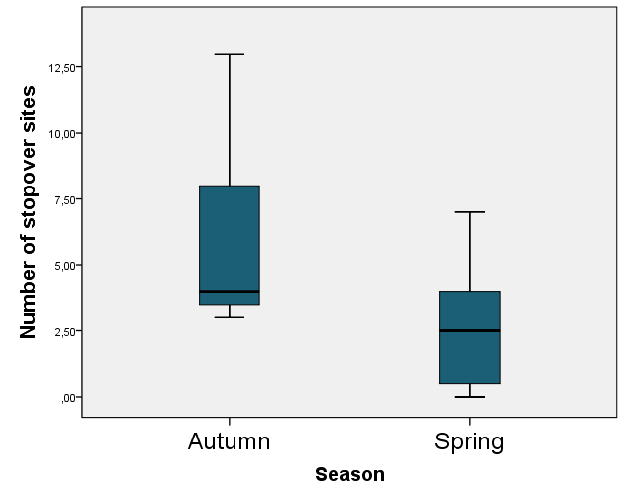
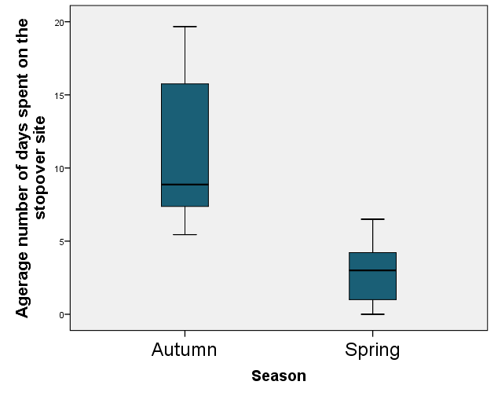
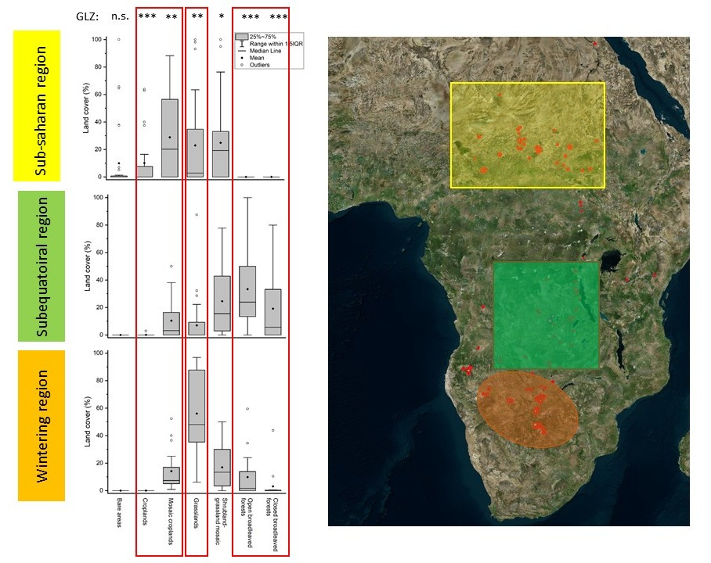
Habitat use of the European roller (Coracias garrulus) through the full annual cycle
Orsolya Kiss¹, Béla Tokody²
European Grassland Conference, Tolosa, Spain
12-18, September, 2022
¹ University of Szeged, Faculty of Agriculture, 6800, Hódmezővásárhely, Andrássy u. 15.
² BirdLife Hungary, 1121, Budapest, Költő u. 21.
Email of the corresponding author: orsolyakiss22@gmail.com
Aims and goals
Identify the important habitats of European rollers throughout the full annual cycle
Home-range size and habitat use during the breeding period
Migration phenology and pathways
Location and characteristics of stopover sites
Location and characteristics of wintering areas
Home–range size | Kde50 (ha) | Kde75 (ha) | Kde90 (ha) | MCP90 (ha)
min-max | 1.31-50.6 | 9.4-104.9 | 3.93-268 | 4.7-342
mean (SE) | 19.4(18.1) | 38.4 (6.4) | 96(15) | 81.2 (17)
Methods - Breeding season
27 adult rollers 2015-2020 at the RollerLife project sites
ECOTONE Pica UHF logger
Home-range and habitat use: MCP 90%, Kernel-density estimation: 50, 75, 90 %
QGIS 3.10, R ”adehabitatHR”, ‚SP,’ raster package
Ecosystem map of Hungary
Total home-range and weekly periods from 1st June to the end of July (8 periods)
European roller (Coracias garrulus)
Middle-size insectivores species
Breeding in large cavities, foraging on grasslands
Migratory species
Large decline all over the European breeding range
Breeding stage affected the home-range size (mixed-effects model, fixed factor: home-range size, random factor: bird ID)
HR type | young hatchling | active feeding of nestlings | p (fixed factor)
kde50 (se) | 21.3 (4.45) | 29.5 (5.2) | 0.273
kde75 (se) | 62.6 (14.1) | 91.7 (18.8) | 0.046
kde90 (se | 99.6 (20.2) | 140 (21.3) | 0.024
Migration phenology
Autumn migration starts at the end of August and (min: 30/08., max. 26/09)
Rollers spend on average 40 days in the Sub-Saharan (Sahel) region
Wintering from the December to March (min: 26/11.26, max. 02/01; min: 26/02, max. 19/03)
Spring migration is shorter (77.5± 10 days vs 89 ± 10 days)
Spring migration routes are longer (8078 km 9736 km vs. 8078 km)
l
hh
K
kk
Breeding
Methods - Non-breeding season
9 adult rollers from 5 subpopulations representing the distribution of Hungarian population
5 gr PTT-100 (Microwave Telemetry Inc., Columbia, MD, USA), 8-h ON/ 15-h OFF and 10-h ON/ 24-h OFF (2016-2020)
Ring recovery data (1931-2017) (BirdLife Hungary, Ringing Center)
Globcover 2009
MODIS Land Land Cover .05 deg Yearly Combined (IGBP)
NDVI : MODIS Land Vegetation Indices 250m 16d Terra
Spring
migration
Autumn migration
Overwintering
Results - Identifid stopovers
Autumn: 69 , spring 31
Spring:
East-Africa: 13
Middle East: 9
Other (Angola, Zambia, South-Sudan, KDR): 9
Autumn:
Sub-Saharan region: 33
Subequatorial region: 36
Discussion
Breeding season
Rollers use on average 20 ha core area during the breeding season, but the average 90% home-range is 80-90 ha.
Increase in home-range size may suggest use new feeding area
e.g. freshly mowed areas
Non-breeding season
Three migration pathways
Sub-Saharan region (Sahel) was found the most important stopover site
Grassland dominance on the wintering site and cropland dominance on the Sub-Saharian region.
Different wintering areas, potential subpopulation level differences
Acknowledgments
NKFIH Tudományos Mecenatúra MEC_R 140738.
Palatitz Péter, Prommer Mátyás, Sümegi Zsófia, Barabás Lilla, Borbáth Erna, Csibrány Balázs, Enyedi Róbert, Fenyvesi László, Hencz Péter, Horváth Éva, Karcza Zsolt, Katona József, Kaufmann Gábor, Kiss Viktor, Kiss Dorottya, Kiss Tamás, Kotymán László, Lendvai Csaba, Luca Márk, Lukács Katalin, Ludnai Tünde, Ócsai Péter, Péntek István, Solt Szabolcs, Szántó Bence, Szász László, Széles Tamás, Szűcs Péter, Tihanyi Gábor , Török Hunor, Végvári Zsolt, Kelemen András.

